Slide 1
APACHE
HTTP Server

Slide 2
COURSE MATERIALS
You can access the course materials via this link
http://goo.gl/LwyPUe

Slide 3

CONTENTS
History
Clients, servers and URLs
Anatomy of request and response
HTTP status codes
Web servers
Apache HTTP Server components
Documentation explained
Directives examples
.htacess
Modules
Virtual hosts

Slide 4



HISTORY
1994
Developed by Rob McCool at the National Center for Supercomputing Applications, University of Illinois
1995
Brian Behlendorf and Cliff Skolnick with others continued the development after Rob McCool had stopped the development
1999
Apache Software Foundation (ASF) formed to provide organizational, legal, and financial support for the Apache HTTP Server
History

Slide 5
Apache Software Foundation (ASF) is an American non-profit corporation to support Apache software projects, including the Apache HTTP Server. The ASF was formed from the Apache Group in June 1999
“

Slide 6
WEB ADDRESS
Addresses on the Web are expressed with URLs - Uniform Resource Locators - which specify
a protocol (e.g. http),
a servername (e.g. www.apache.org),
a URL-path (e.g. /docs/current/getting-started.html), and
possibly a query string (e.g. ?arg=value) used to pass additional arguments to the server
Clients, Servers, and URLs

Slide 7
CLIENT/SERVER
A client (e.g., a web browser) connects to a server (e.g., your Apache HTTP Server), with the specified protocol, and makes a request for a resource using the URL-path.
The URL-path may represent any number of things on the server. It may be a file (like getting-started.html) or some kind of program file (like index.php).
Clients, Servers, and URLs

Slide 8
RESPONSE
The server will send a response consisting of
a status code and,
optionally, a response body.
The status code indicates whether the request was successful, and, if not, what kind of error condition there was. This tells the client what it should do with the response.
Clients, Servers, and URLs

Slide 9
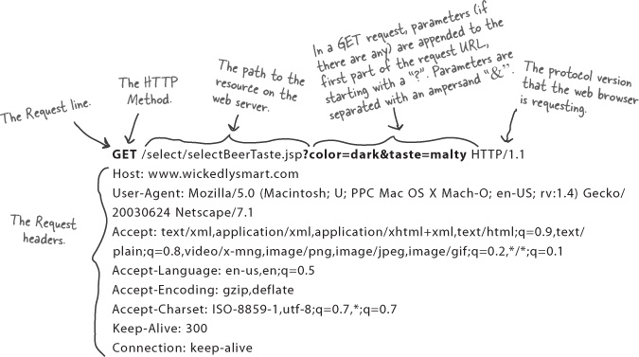
ANATOMY OF GET REQUEST
Anatomy of request and response

Slide 10
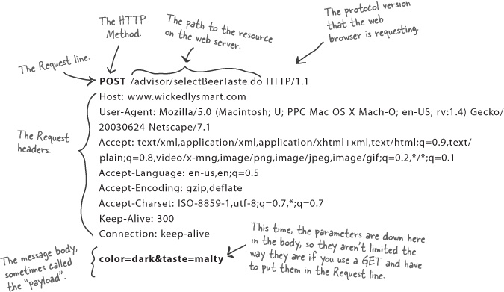
ANATOMY OF POST REQUEST
Anatomy of request and response

Slide 11
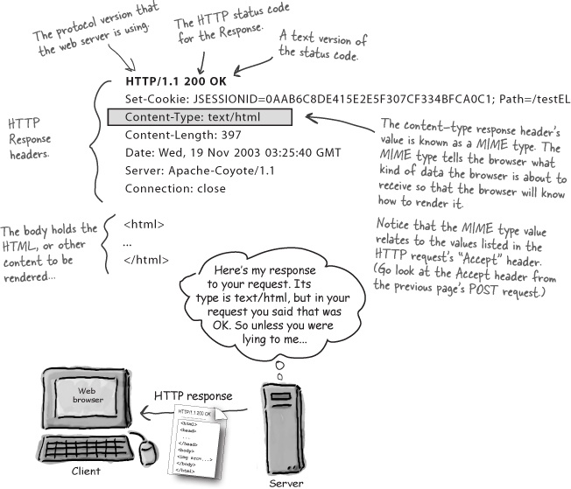
ANATOMY OF RESPONSE
Anatomy of request and response

Slide 12
HTTP STATUS CODES
1xx Informational
2xx Success
3xx Redirection
4xx Client Error
5xx Server Error
Status Codes

Slide 13
HTTP STATUS CODES EXAMPLES
200 OK
401 Unauthorized
403 Forbidden
404 Not Found
500 Internal Server Error
See full list at:
http://www.w3.org/Protocols/rfc2616/rfc2616-sec10.html
Status Codes

Slide 14
WHAT IS A WEB SERVER?
This is a computer that's sole purpose is to distribute information that is hosted within its hard drives.
Depending on the information, it is accessed and distributed differently.
A detailed example would be standard Web Pages that are accessed via the Internet protocol HTTP on port 80 and distributed back in the same fashion which are stored on a web server.
Web Servers

Slide 15
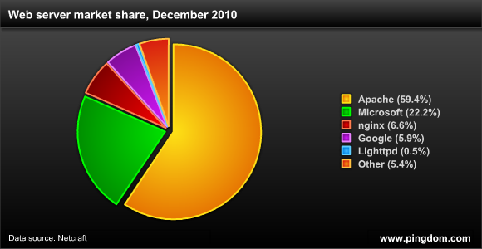
WHAT IS A WEB SERVER?
Any computer can be turned into a Web server by installing server software and connecting the machine to the Internet.
There are many Web server software applications.
Web Servers

Slide 16
APACHE VS IIS
Apache is free while IIS is packaged with Windows.
IIS only runs on Windows while Apache can run on almost any OS including UNIX, Apple’s OS X, and on most Linux Distributions.
IIS has a dedicated staff to answer most problems while support for Apache comes from the community itself.
IIS is optimized for Windows because they are from the same company.
The Windows OS is prone to security risks.
Web Servers

Slide 17
CONFIGURATION FILES
The Apache HTTP Server is configured via simple text files.
The default configuration file is usually called httpd.conf.
The configuration is frequently broken into multiple smaller files, for ease of management. These files are loaded via the Include directive.
Apache HTTP Server components

Slide 18
DIRECTIVES
The server is configured by placing configuration directives in configuration files.
A directive is a keyword followed by one or more arguments that set its value.
In addition to the main configuration files, certain directives may go in .htaccess files located in the content directories. .htaccess files are primarily for people who do not have access to the main server configuration file(s)
Apache HTTP Server components

Slide 19
MODULES
Apache has always accommodated a wide variety of environments through its modular design.
This design allows the web-master to choose which features will be included in the server by selecting which modules to load either at compile-time or at run-time.
Module
Module
Core
Module
Module
Apache HTTP Server components

Slide 20
INSTALLATION
For Ubuntu/Debian :
$ Sudo apt-get update
$ Sudo apt-get install tasksel
$ Sudo tasksel install lamp-server
For CentOS/Red Hat Distros:
# yum install httpd
# service httpd start
INSTALLATION
Notes:
--host=host_name
--user=user_name
--password=your_pass
If you do decide to specify the password on the command line, note particularly
that there is no space between the -p option and the following password value.This
behavior of -p is a common point of confusion, because it differs from the -h and
-u options, which are associated with the word that follows them regardless of
whether there is a space between the option and the word.

Slide 21
MAIN CONFIGURATION FILE
Ubuntu:
/etc/apache2/apache2.conf
CentOS:
/etc/httpd/conf/httpd.conf
INSTALLATION
Notes:
--host=host_name
--user=user_name
--password=your_pass
If you do decide to specify the password on the command line, note particularly
that there is no space between the -p option and the following password value.This
behavior of -p is a common point of confusion, because it differs from the -h and
-u options, which are associated with the word that follows them regardless of
whether there is a space between the option and the word.

Slide 22
PUBLIC WEB FILES / LOG FILES
Ubuntu:
/var/www/html
/var/log/apache2
CentOS:
/var/www/html
/var/log/httpd
INSTALLATION
Notes:
--host=host_name
--user=user_name
--password=your_pass
If you do decide to specify the password on the command line, note particularly
that there is no space between the -p option and the following password value.This
behavior of -p is a common point of confusion, because it differs from the -h and
-u options, which are associated with the word that follows them regardless of
whether there is a space between the option and the word.

Slide 23
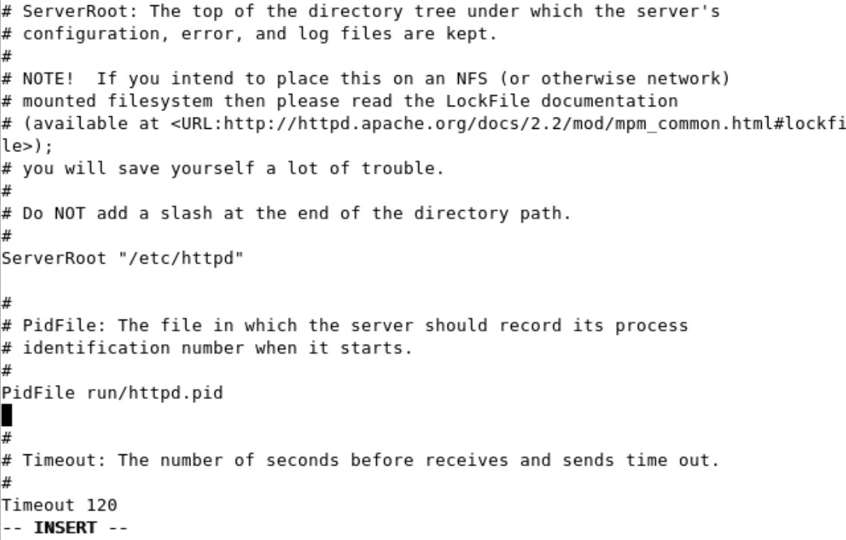
MAIN CONFIGURATION FILE
INSTALLATION
Notes:
--host=host_name
--user=user_name
--password=your_pass
If you do decide to specify the password on the command line, note particularly
that there is no space between the -p option and the following password value.This
behavior of -p is a common point of confusion, because it differs from the -h and
-u options, which are associated with the word that follows them regardless of
whether there is a space between the option and the word.

Slide 24
DIRECTIVES EXAPMLES
ServerRoot directive
The path to the server’s configuration
PidFile directive
The process identification number for the httpd registered at starting the server
ServerName directive
This is where you declare the name of your website
DocumentRoot directive
This is where your web documents (html files, images etc) should be located.
Listen directive
The Listen directive instructs Apache httpd to listen to only specific IP addresses or ports
Apache HTTP Server components

Slide 25
DIRECTIVES DESCRIPTION
Description: | A brief description of the purpose of the directive.
Syntax: | This indicates the format of the directive as it would appear in a configuration file
Status: | This indicates how tightly bound into the Apache Web server the directive: Core: means it is part of the innermost portions of the Apache Web server, and is always available. MPM: is provided by a Multi-Processing Module. Base: supported by one of the standard Apache modules which is compiled into the server by default, and is therefore normally available. Extension: is provided by one of the modules included with the Apache server kit, but the module isn't normally compiled into the server.
Module: | This quite simply lists the name of the source module which defines the directive.
Documentation explained

Slide 26
DIRECTIVES DESCRIPTION
Context: | This indicates where in the server's configuration files the directive is legal. Server config: This means that the directive may be used in the server configuration files (e.g., httpd.conf), but not within any <VirtualHost> or <Directory> containers. It is not allowed in .htaccess files at all. Virtual host :This context means that the directive may appear inside <VirtualHost> containers in the server configuration files. Directory :A directive marked as being valid in this context may be used inside <Directory>, <Location>, <Files>, and <Proxy> containers in the server configuration files, subject to the restrictions outlined in Configuration Sections. .htaccess: If a directive is valid in this context, it means that it can appear inside per-directory .htaccess files. It may not be processed, though depending upon the overrides currently active.
Documentation explained

Slide 27
AllowOverride
Description: | Types of directives that are allowed in .htaccess files
Syntax: | AllowOverride All|None|directive-type [directive-type] ...
Default: | AllowOverride None (2.3.9 and later), AllowOverride All (2.3.8 and earlier)
Context: | directory
Status: | Core
Module: | core
When the server finds an .htaccess file (as specified by AccessFileName) it needs to know which directives declared in that file can override earlier configuration directives.
Directives examples

Slide 28
KeepAlive
Description: | Enables HTTP persistent connections
Syntax: | KeepAlive On|Off
Default: | KeepAlive On
Context: | server config, virtual host
Status: | Core
Module: | core
The Keep-Alive extension to HTTP/1.0 and the persistent connection feature of HTTP/1.1 provide long-lived HTTP sessions which allow multiple requests to be sent over the same TCP connection. In some cases this has been shown to result in an almost 50% speedup in latency times for HTML documents with many images. To enable Keep-Alive connections, set KeepAlive On.
Directives examples

Slide 29
MaxKeepAliveRequests
Description: | Number of requests allowed on a persistent connection
Syntax: | MaxKeepAliveRequests number
Default: | MaxKeepAliveRequests 100
Context: | server config, virtual host
Status: | Core
Module: | core
The MaxKeepAliveRequests directive limits the number of requests allowed per connection when KeepAlive is on. If it is set to 0, unlimited requests will be allowed. We recommend that this setting be kept to a high value for maximum server performance.
Directives examples

Slide 30
ErrorLog
Description: | Location where the server will log errors
Syntax: | ErrorLog file-path|syslog[:facility]
Default: | ErrorLog logs/error_log (Unix) ErrorLog logs/error.log (Windows and OS/2)
Context: | server config, virtual host
Status: | Core
Module: | core
The ErrorLog directive sets the name of the file to which the server will log any errors it encounters. If the file-path is not absolute then it is assumed to be relative to the ServerRoot
Directives examples

Slide 31
Directory
Description: | Enclose a group of directives that apply only to the named file-system directory, sub-directories, and their contents.
Syntax: | <Directory directory-path> ... </Directory>
Context: | server config, virtual host
Status: | Core
Module: | core
<Directory> and </Directory> are used to enclose a group of directives that will apply only to the named directory, sub-directories of that directory, and the files within the respective directories. Any directive that is allowed in a directory context may be used.
Directives examples

Slide 32
DirectoryMatch
Description: | Enclose directives that apply to the contents of file-system directories matching a regular expression.
Syntax: | <DirectoryMatch regex> ... </DirectoryMatch>
Context: | server config, virtual host
Status: | Core
Module: | core
<DirectoryMatch> and </DirectoryMatch> are used to enclose a group of directives which will apply only to the named directory (and the files within), the same as <Directory>. However, it takes as an argument a regular expression
Directives examples

Slide 33
Files
Description: | Contains directives that apply to matched filenames
Syntax: | <Files filename> ... </Files>
Context: | server config, virtual host, directory, .htaccess
Override: | All
Status: | Core
Module: | core
The <Files> directive limits the scope of the enclosed directives by filename. It is comparable to the <Directory> and <Location> directives. It should be matched with a </Files> directive. The directives given within this section will be applied to any object with a basename (last component of filename) matching the specified filename
Directives examples

Slide 34
FilesMatch
Description: | Contains directives that apply to regular-expression matched filenames
Syntax: | <FilesMatch regex> ... </FilesMatch>
Context: | server config, virtual host, directory, .htaccess
Override: | All
Status: | Core
Module: | core
The <FilesMatch> directive limits the scope of the enclosed directives by filename, just as the <Files> directive does. However, it accepts a regular expression.
Directives examples

Slide 35
Allow
Description: | Controls which hosts can access an area of the server
Syntax: | Allow from all|host|env=[!]env-variable [host|env=[!]env-variable] ...
Context: | directory, .htaccess
Override: | Limit
Status: | Extension
Module: | mod_access_compat
The Allow directive affects which hosts can access an area of the server. Access can be controlled by hostname, IP address, IP address range, or by other characteristics of the client request captured in environment variables.
Directives examples

Slide 36
Deny
Description: | Controls which hosts are denied access to the server
Syntax: | Deny from all|host|env=[!]env-variable [host|env=[!]env-variable] ...
Context: | directory, .htaccess
Override: | Limit
Status: | Extension
Module: | mod_access_compat
This directive allows access to the server to be restricted based on hostname, IP address, or environment variables. The arguments for the Deny directive are identical to the arguments for the Allow directive.
Directives examples

Slide 37
Order
Description: | Controls the default access state and the order in which Allow and Deny are evaluated.
Syntax: | Order ordering
Context: | directory, .htaccess
Override: | Limit
Status: | Extension
Module: | mod_access_compat
The Order directive, along with the Allow and Deny directives, controls a three-pass access control system. The first pass processes either all Allow or all Deny directives, as specified by the Order directive. The second pass parses the rest of the directives (Deny or Allow). The third pass applies to all requests which do not match either of the first two.
Directives examples

Slide 38
CacheEnable
Description: | Enable caching of specified URLs using a specified storage manager
Syntax: | CacheEnable cache_type [url-string]
Context: | server config, virtual host, directory, .htaccess
Override: | Extension
Status: | mod_cache
Module: | Enable caching of specified URLs using a specified storage manager
The CacheEnable directive instructs mod_cache to cache urls at or below url-string. The cache storage manager is specified with the cache_type argument. The CacheEnable directive can alternatively be placed inside either <Location> or <LocationMatch> sections to indicate the content is cacheable.
Directives examples

Slide 39
.htaccess
.htaccess stands for hypertext access. This is the default name of the Apache directory-level configuration file.
One of the most common uses is to require user authentication in order to serve certain web pages.
Also you can use it to define rewrite rules and rewrite conditions.
You need to configure apache using AllowOverride directive to allow/deny the usage of .htaccess
.htaccess

Slide 40
.htaccess FOR AUTHENTICATION
#.htaccess content
AuthType Basic
AuthName “Restricted web page”
AuthUserFile “/var/www/.htpasswd”
require valid-user
To create .htpasswd use this command
htpasswd -c .htpasswd username
.htaccess

Slide 41
.htaccess FOR AUTHENTICATION
AuthType Basic defines the type of authentication.
Basic means there is no encryption and the password hash is sent as clear text. This is one of the major reasons why .htaccess cannot be considered for protection of confidential user data.
"Restricted web page" is a window title string. When someone tries to access an .htaccess-protected page, a username & password window will pop in the web browser. This window will bear a title - this is the AuthName. It can be anything you like.
AuthUserFile /var/www/.htpasswd defines the path to a file where user credentials are stored. This file does not exist, but we will create it soon.
require valid-user indicates only successful authentication attempts will result in the loading of the page.
.htaccess

Slide 42
MODULES
You can always list the modules currently used by the server. The command below will display only the modules compiled into Apache.
$ httpd -l
To list all modules, both static and shared
$ httpd -m
To enable module (Ubuntu only!)
$ sudo a2enmod rewrite
Modules

Slide 43
LoadModule
Description: | Links in the object file or library, and adds to the list of active modules
Syntax: | LoadModule module filename
Context: | server config
Override: | Extension
Status: | mod_so
Module: | Links in the object file or library, and adds to the list of active modules
The LoadModule directive links in the object file or library filename and adds the module structure named module to the list of active modules. Module is the name of the external variable of type module in the file, and is listed as the Module Identifier in the module documentation
Modules

Slide 44
IfModule
Description: | Encloses directives that are processed conditional on the presence or absence of a specific module
Syntax: | <IfModule [!]module-file|module-identifier> ... </IfModule>
Context: | server config, virtual host, directory, .htaccess
Override: | All
Status: | Core
Module: | core
The <IfModule test>...</IfModule> section is used to mark directives that are conditional on the presence of a specific module. The directives within an <IfModule> section are only processed if the test is true. If test is false, everything between the start and end markers is ignored.
Modules

Slide 45
MULTI-PROCESSING MODULES (MPMS)
Apache 2.x supports pluggable concurrency models, called Multi-Processing Modules (MPMs). When building Apache, you must choose an MPM to use.
The choice of MPM can affect the speed and scalability of the httpd:
The worker MPM
The event MPM
The prefork MPM
Modules

Slide 46
PREFORK MODULE
This Multi-Processing Module (MPM) implements a non-threaded, pre-forking web server.
Each server process may answer incoming requests, and a parent process manages the size of the server pool. It is appropriate for sites that need to avoid threading for compatibility with non-thread-safe libraries.
It is also the best MPM for isolating each request, so that a problem with a single request will not affect any other.
Modules

Slide 47
PREFORK MODULE
<IfModule mpm_prefork_module>
StartServers 5
MinSpareServers 5
MaxSpareServers 10
MaxClients 150
</IfModule>
Modules

Slide 48
WORKER MODULE
This Multi-Processing Module (MPM) implements a hybrid multi-process multi-threaded server.
By using threads to serve requests, it is able to serve a large number of requests with fewer system resources than a process-based server.
It retains much of the stability of a process-based server by keeping multiple processes available, each with many threads.
Modules

Slide 49
WORKER MODULE
<IfModule mpm_worker_module>
StartServers 2
MinSpareThreads 25
MaxSpareThreads 75
ThreadsPerChild 25
MaxRequestWorkers 150
</IfModule>
Modules

Slide 50
EVENT MODULE
The event MPM is threaded like the Worker MPM, but is designed to allow more requests to be served.
Run-time configuration directives are identical to those provided by worker, with the only addition of the AsyncRequestWorkerFactor.
KeepAlive may lead to situations where all workers are tied up and no worker thread is available to handle new work.
To mitigate this problem, the event MPM does two things:
it limits the number of connections accepted per process, depending on the number of idle request workers;
if all workers are busy, it will close connections in keep-alive state even if the keep-alive timeout has not expired.
Modules

Slide 51
EVENT MODULE
<IfModule mpm_event_module>
StartServers 2
MinSpareThreads 25
MaxSpareThreads 75
ThreadsPerChild 25
MaxRequestWorkers 150
AsyncRequestWorkerFactor 2
</IfModule>
Modules

Slide 52
REWRITE MODULE
The Apache module mod_rewrite is a very powerful and sophisticated module which provides a way to do URL manipulations.
With it, you can do nearly all types of URL rewriting that you may need. It is, however, somewhat complex, and may be intimidating to the beginner.
You need to know:
How to construct regular expression:
What is the RewriteRule?
What is the RewriteCond?
Modules

Slide 53
REGEX VOCABULARY
Character | Meaning
. | Matches any single character
+ | Repeats the previous match one or more times
* | Repeats the previous match zero or more times.
? | Makes the match optional.
^ | Called an anchor, matches the beginning of the string
$ | The other anchor, this matches the end of the string.
( ) | Groups several characters into a single unit, and captures a match for use in a backreference.
[ ] | A character class - matches one of the characters
[^ ] | Negative character class - matches any character not specified
! | can be used before a regular expression to negate it
Modules

Slide 54
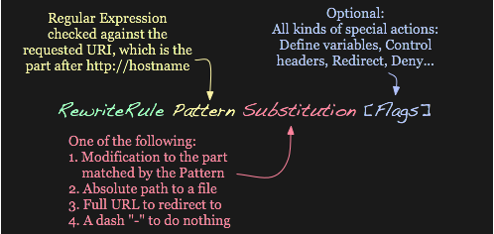
RewriteRule BASICS
A RewriteRule consists of three arguments separated by spaces. The arguments are
Pattern: which incoming URLs should be affected by the rule;
Substitution: where should the matching requests be sent;
[flags]: options affecting the rewritten request.
Modules

Slide 55
RewriteRule BASICS
The Substitution can itself be one of three things:
A full filesystem path to a resource
RewriteRule "^/games" "/usr/local/games/web"
This maps a request to an arbitrary location on your filesystem, much like the Alias directive.
A web-path to a resource
RewriteRule "^/foo$" "/bar"
If DocumentRoot is set to /var/www/html/, then this directive would map requests for http://example.com/foo to the path /var/www/html/bar.
Modules

Slide 56
RewriteRule BASICS
An absolute URL
RewriteRule "^/product/view$" "http://site2.example.com/seeproduct.html" [R]
This tells the client to make a new request for the specified URL.
The Substitution can also contain back-references to parts of the incoming URL-path matched by the Pattern. Consider the following:
RewriteRule "^/product/(.*)/view$" "/var/web/productdb/$1"
Modules

Slide 57
Rewrite FLAGS
The behavior of a RewriteRule can be modified by the application of one or more flags to the end of the rule.
[NC] flag causes the RewriteRule to be matched in a case-insensitive manner.
RewriteRule "^puppy.html" "smalldog.html" [NC]
[R] flag causes a HTTP redirect to be issued to the browser. If a fully-qualified URL is specified (that is, including http://servername/) then a redirect will be issued to that location. Otherwise, the current protocol, servername, and port number will be used to generate the URL sent with the redirect
For more flags, see
http://httpd.apache.org/docs/2.4/rewrite/flags.html
Modules

Slide 58
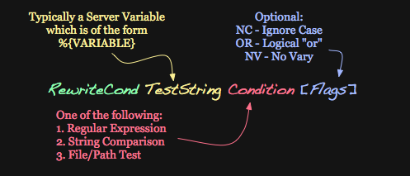
Rewrite CONDITIONS
One or more RewriteCond directives can be used to restrict the types of requests that will be subject to the following RewriteRule.
The first argument is a variable describing a characteristic of the request,
the second argument is a regex that must match the variable,
and a third optional argument is a list of flags that modify how the match is evaluated.
Modules

Slide 59
Rewrite CONDITIONS EXAMPLES
For example, to send all requests from a particular IP range to a different server, you could use:
RewriteCond "%{REMOTE_ADDR}" "^10\.2\."
RewriteRule "(.*)" "http://intranet.example.com$1"
When more than one RewriteCond is specified, they must all match for the RewriteRule to be applied.
For example, to deny requests that contain the word "hack" in their query string, unless they also contain a cookie containing the word "go", you could use:
RewriteCond "%{QUERY_STRING}" "hack"
RewriteCond "%{HTTP_COOKIE}" "!go"
RewriteRule "." "-" [F]
Modules

Slide 60
Rewrite CONDITIONS EXAMPLES
Matches in the regular expressions contained in the RewriteConds can be used as part of the Substitution in the RewriteRule using the variables %1, %2, etc.
For example, this will direct the request to a different directory depending on the hostname used to access the site:
RewriteCond "%{HTTP_HOST}" "(.*)"
RewriteRule "^/(.*)" "/sites/%1/$1"
If the request was for http://example.com/foo/bar, then %1 would contain example.com and $1 would contain foo/bar.
Modules

Slide 61
VIRTUAL HOST
The term Virtual Host refers to the practice of running more than one web site (such as company1.example.com and company2.example.com) on a single machine.
Virtual hosts can be "IP-based", meaning that you have a different IP address for every web site, or "name-based", meaning that you have multiple names running on each IP address.
The fact that they are running on the same physical server is not apparent to the end user.
Virtual Host

Slide 62
IP-BASED
the server must have a different IP address/port combination for each IP-based virtual host.
<VirtualHost 172.20.30.40:80>
ServerAdmin webmaster@www1.example.com
DocumentRoot "/www/vhosts/www1"
ServerName www1.example.com
ErrorLog "/www/logs/www1/error_log"
CustomLog "/www/logs/www1/access_log" combined
</VirtualHost>
<VirtualHost 172.20.30.50:80>
DocumentRoot "/www/vhosts/www2"
ServerName www2.example.org
ErrorLog "/www/logs/www2/error_log"
CustomLog "/www/logs/www2/access_log" combined
</VirtualHost>
Virtual Host

Slide 63
NAME-BASED
<VirtualHost *:80>
# This first-listed virtual host is also the default for *:80
ServerName www.example.com
ServerAlias example.com
DocumentRoot "/www/domain"
</VirtualHost>
<VirtualHost *:80>
ServerName other.example.com
DocumentRoot "/www/otherdomain"
</VirtualHost>
Virtual Host

Slide 64
VIRTUAL HOST
Any request that doesn't match an existing <VirtualHost> is handled by the global server configuration, regardless of the hostname or ServerName.
To be accessible by more than one name. use ServerAlias directive, placed inside the <VirtualHost> section.
ServerAlias example.com *.example.com
Virtual Host

